Slide 1
Report Topic: Quantum Computing
Zak Rowland – Computer Hardware

Slide 2
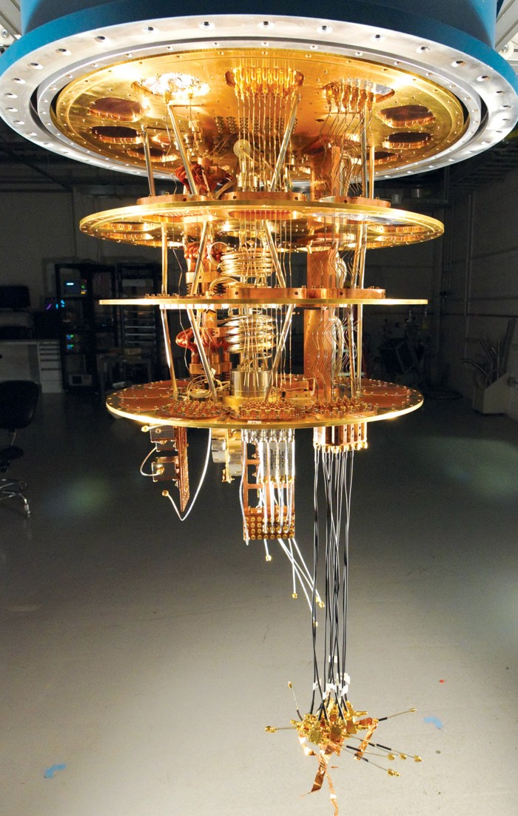
Quantum Computing
Research Questions:
What is it?
What are the benefits over current technology?
How much progress has been made?
How does this apply to Moore's Law?
Will it ever be "the standard?"

Slide 3
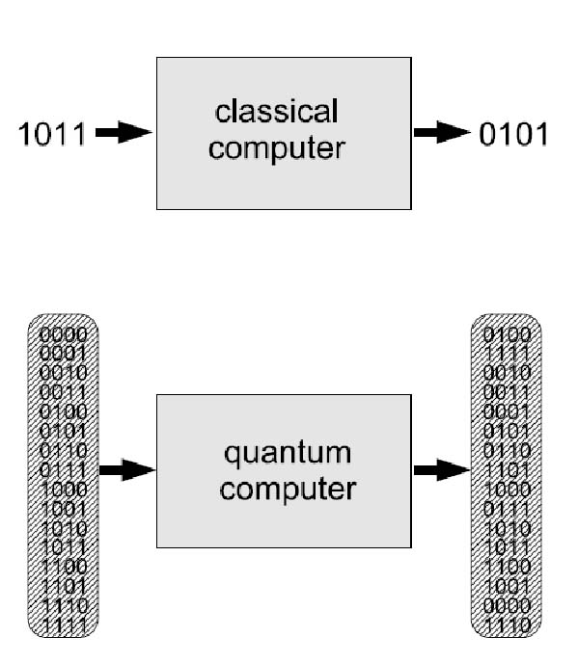
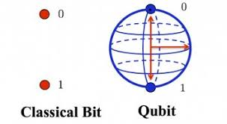
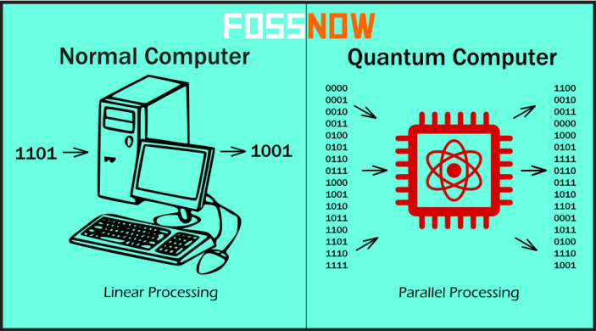
Quantum Computing - What is it?
Normal Computers:
Bits
Either ( 1 or 0 )
Quantum Computers:
Qubits
Can be either ( 1 or 0 ) simultaneously
Superposition and Entanglement

Slide 4
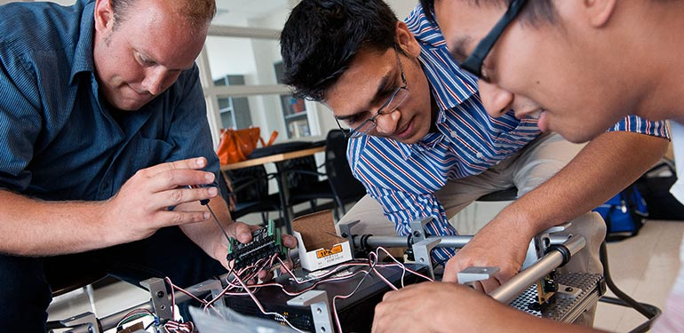
Who should care?
Action to take?
Just be prepared for a possible change in the way computers work
Mainly computer scientists and engineers
Software engineers
Hardware Engineers
Computer Science
Information Technology ( IT )
Etc ...

Slide 5
Research and Citation System
Research so far:
Skimming various articles and scholarly documents
The simple concepts and differences from normal computing
Some past knowledge from research, videos, articles (enough to be interested)
Still unsure of how the computer is built to use the qubits to process information
Citation System:
IEEE
One of the most common engineering formats

Slide 6
Citation
Images:
https://images.app.goo.gl/QSUx2nHJiaRCYBDE8
https://images.app.goo.gl/dpQNKBfvSgyBVZrY6
https://images.app.goo.gl/TeaMqyvm84YMKVtE9
https://images.app.goo.gl/makcL63GV7rLmu7g7
https://images.app.goo.gl/HUMNn2e3Uzza85ti6
Articles:
https://alliance-primo.hosted.exlibrisgroup.com/primo-explore/fulldisplay?docid=CP51246566590001451&context=L&vid=OIT&search_scope=oit_alma_summit_primo_central&tab=default_tab&lang=en_US
https://medium.com/@techindustan/quantum-computing-explained-simply-and-how-actually-quantum-computers-work-c6e0667f3468

